Slide 1
PDM Microphone Interface with BLE

Slide 2

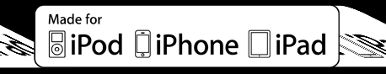

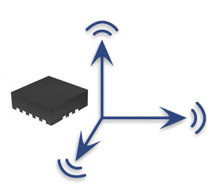
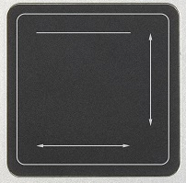
PDM Microphone in Remote Control
PSoC 4 BLE
Cortex M0 MCU
MEMS PDM Interface
BLE
BLE Scheduler
ADPCM
DC Filter
5th order CIC Comb
5th order CIC Integrator (UDB)
PDM
Data
Digital MEMS Microphone
(Direct PDM Input)
Voice over BLE
PDM
Clock
Microphone Sampling Clock Generator
(Fractional Divider)
I2C
CapSense
Motion
Sensor
Trackpad
UDB = Universal Digital Block (PLD)
Optional
All-Digital, Lowest BOM solution
High quality audio decimation for PDM microphones
Active Power (measured): 5mA* @ 24MHz CPU operation
Only 12% CPU utilization for PDM microphones processing (16-bit/16kHz) at 24MHz operation
Microphone interface up to 24-bit/48kHz configuration
Optional Trackpad, Motion Sensor and Proximity Gesture features
*5mA is PDM only current. BLE + PDM + DC filter + ADPCM power consumption is of the order of 11-12mA (non-optimized number)

Slide 3
PSoC 4 BLE PDM Solution
PSoC 4 BLE
Cortex M0 MCU
PDM
Data
5th order CIC Integrator (UDB)
5th order CIC Comb
DC Filter
ADPCM
Digital MEMS Microphone
(Direct PDM Input)
PDM
Clock
Microphone Sampling Clock Generator
(Fractional Divider)
MEMS PDM Interface
Two-wire mic connection, no external components required
5th Order hybrid CIC filter implementation
5th Order Integrator is realized using 4 hardware UDBs*
5th Order Comb, DC filter, and ADPCM (4:1) are implemented in firmware
32-bit datapath for CIC, end result is truncated to 16-bit for ADPCM or similar compression schemes
Minimal firmware (<700 bytes flash & <50 bytes SRAM) & low CPU intervention (<12% CPU usage)
Tested at 24MHz system operation, can go as low as 12MHz (not tested yet)
Additional peripherals (ADC, OpAmp, Comparator, Communication blocks, TCPWMs**, and other PSoC Components) for system integration
CIC droop correction is NOT part of the design
Optional
*UDB = Universal Digital Block **TCPWM = Timer/Counter/PWM block
Notes:
question: any potential interest in stereo operation? That should be possible, with some small compromises.

Slide 4

PDM Voice Performance**
No spurious sidebands
Average THD+N of >-70dB until Fs/3*
Sample
Recording
Amplitude Vs. THD+N
Input Vs. Output
*Measured using Industry standard Prism Dscope equipment with CT detector band pass filter of 22Hz to 8kHz
**Measurement Setup = Prism Analog Signal Generator-> PDM OUT -> PDM block in PSoC 4 BLE -> I2S OUT -> 24-bit Audio DAC -> Prism Analog Signal Analyzer

Slide 5
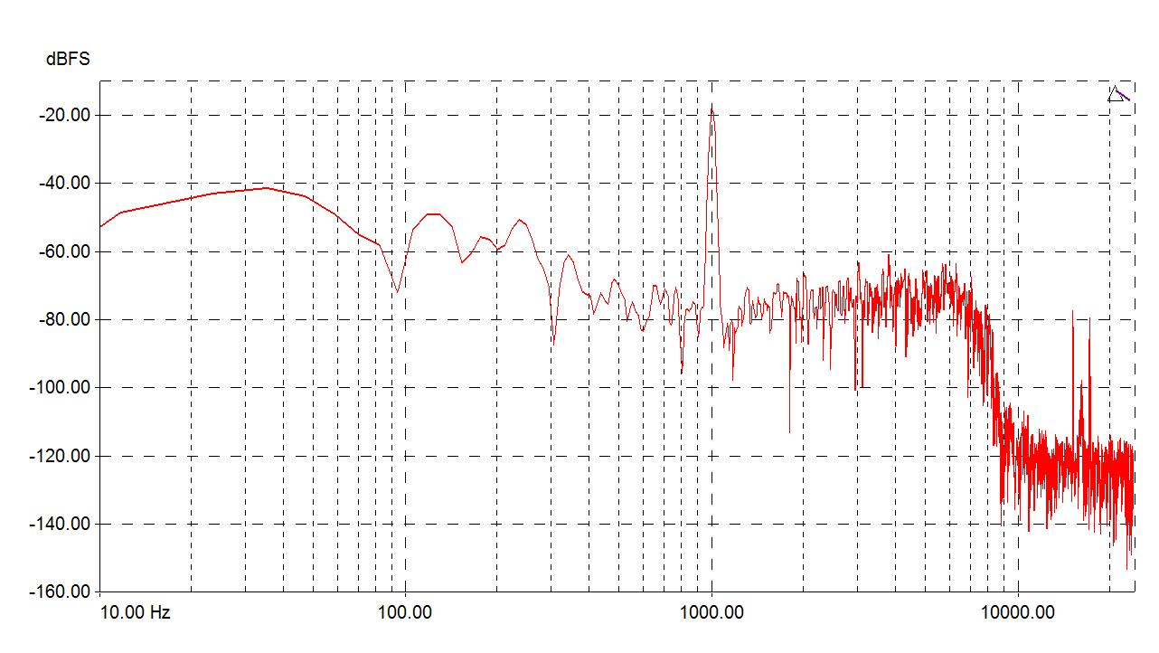
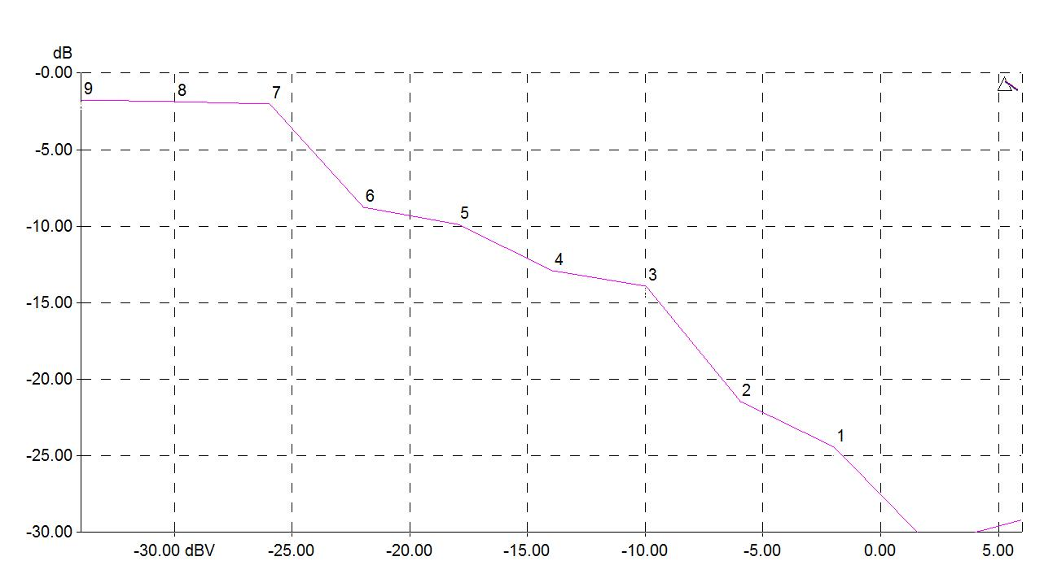
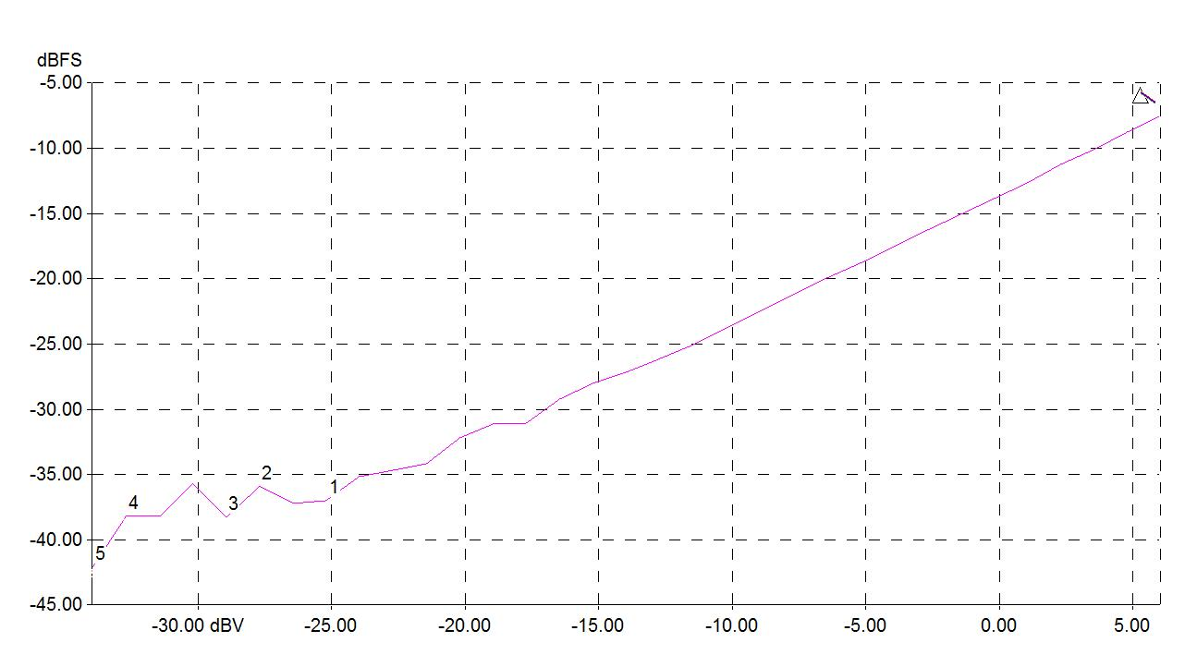
ADPCM over BLE Voice Performance*
1K Tone Frequency Response
Frequency Vs. THD+N
Amplitude Vs. THD+N
Input Vs. Output
*Applies 4:1 ADPCM compression scheme at the output of PDM samples

Slide 6
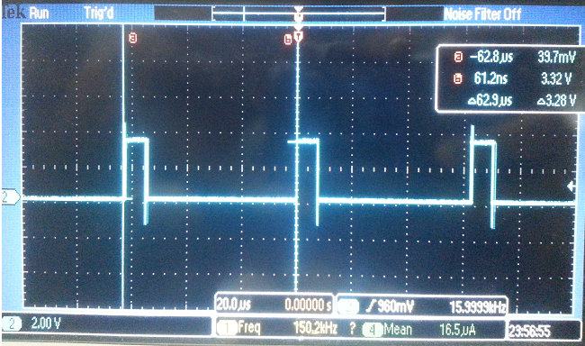
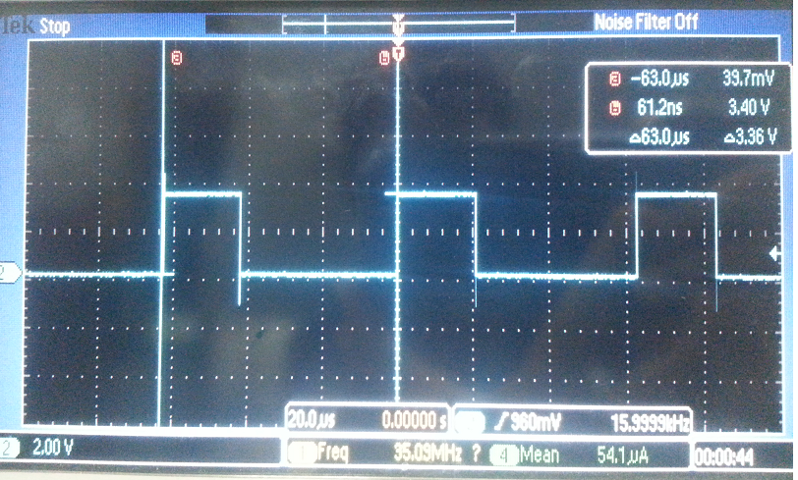
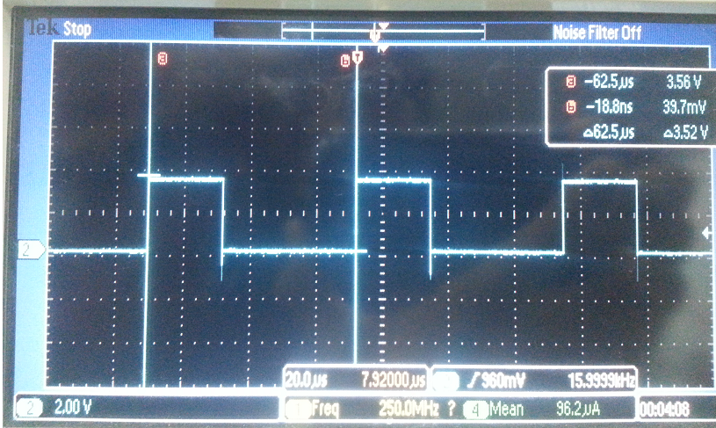
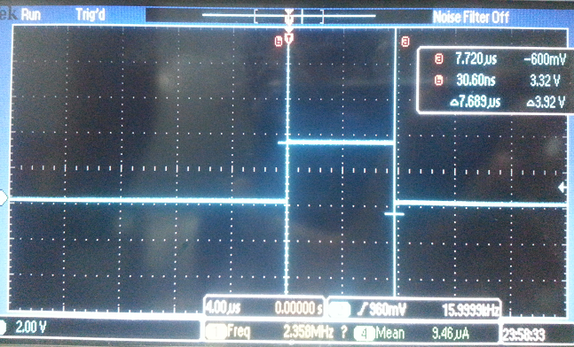
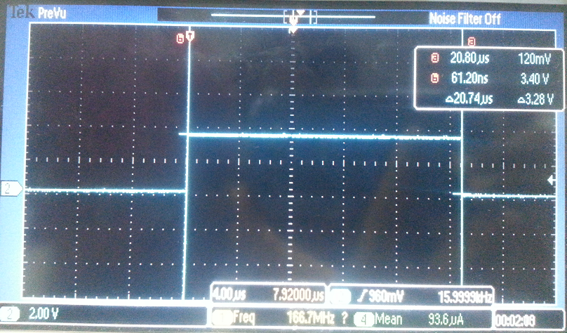
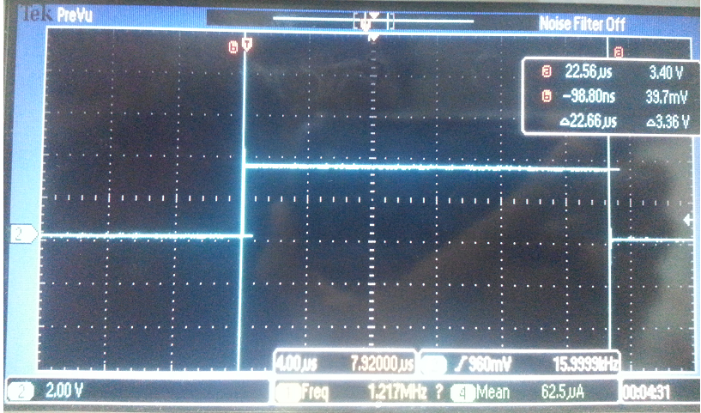
CPU Utilization
Mode | CPU Utilization* %
PDM only | 12% (7.7us every 62.5us)
PDM & ADPCM | 33% (20.7us every 62.5us)
PDM, ADPCM, & DC Filter | 36% (22.6us every 62.5us)
PDM Only
PDM + 4:1 ADPCM Only
PDM, ADPCM & DC Filter
High = PDM ISR active
Cursor Delta = Sampling Rate
PDM Processing ISR
High = PDM ISR active
Cursor Delta = ISR CPU Utilization
PDM ISR CPU Utilization
*System clock set to 24MHz

Slide 7
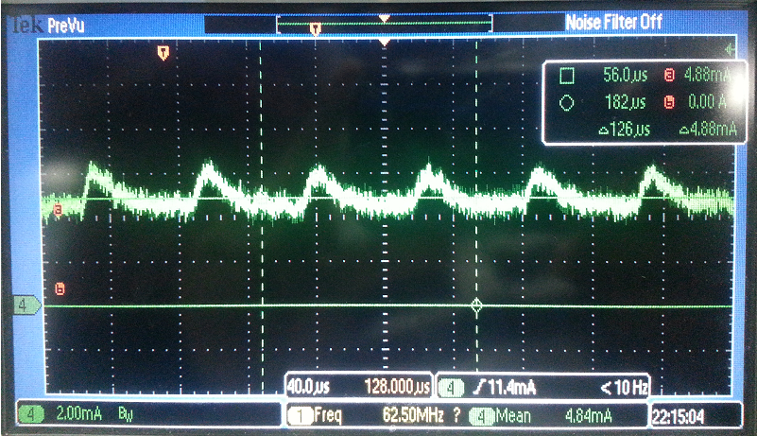
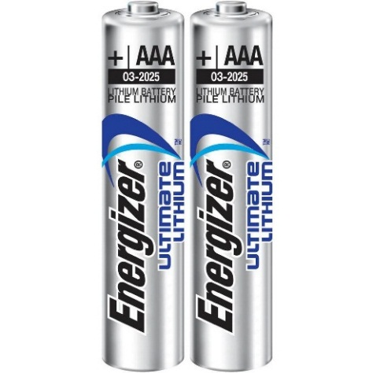
Power Consumption*
PDM Processing Current Waveform
PDM Average Current Calculator
Sleep Current = 4.88mA (Cursor delta)
PDM Processing Current = 6.32mA
PDM Processing Stage | Pulse Current (uA) | Pulse Duration (us) | Total Duration (us) | Average Current (uA)
PDM Mic CPU Filtering | 6320 | 7.7 | 62.5 | 778.624
PDM Mic Hardware Filtering | 4880 | 54.8 | 62.5 | 4278.784
Total PDM Average Active Current |  |  |  | 5057.408
Two AAA 1250mAh Batteries
PDM System Battery Life
PDM Usage Modes | Average Current (uA) | Duration/ Day (mins) | Total Mins/Day (mins) | Average Current (uA)2
PDM Active Mode | 5057.4 | 20 | 1440 | 70.24167
PDM Inactive Mode | 1.3 | 1420 | 1440 | 1.281944
 | Total PDM Current |  |  | 71.52361
 | Battery Capacity (mAh) |  |  | 1250
 | Battery Life (days) |  |  | 728
*The current consumption described here is only for PMD processing and it DOESN’T include BLE interface, ADPCM and DC Filter current

